Slide 1

Walking through different seasons.
Tatiana Frolova
MAT 2180
Sinclair Community College

Slide 2

The project “Walking through different seasons” is about:
Project Walking through different seasons is a project about comparing the mean steps of walking difference between the summer season and winter seasons.
In my assumption that most people have a regular daily routine.
I also have my everyday walking daily routine. Such as gym, walking a dog 3-4 times a day, walking through the house and etc.
I would think that during the winter season and summer seasons I would walk the same amount of steps. No matter weather, or any other factors which might affect my walking routine.
My study would be based on a Garmin watch which are counting steps through the day.

Slide 3
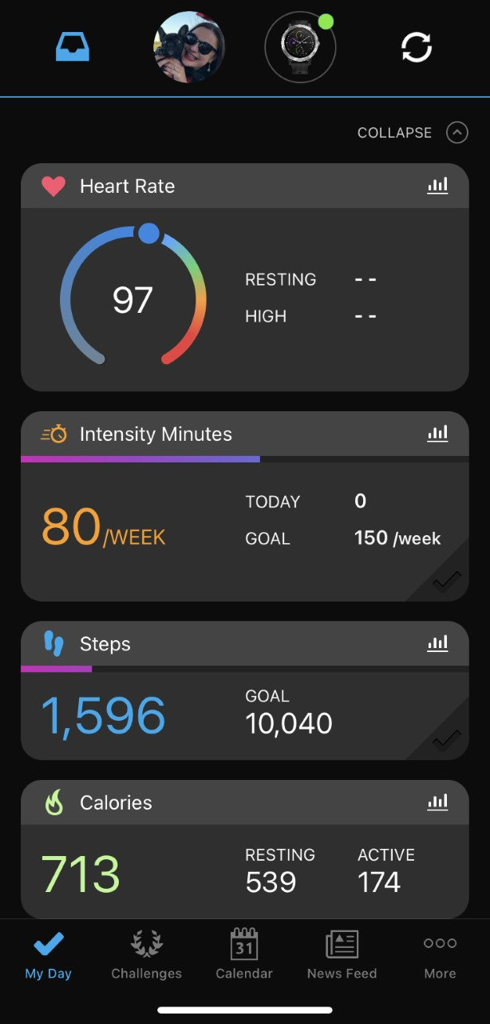
Collected data is a good representative sample because:
1. Two random samples are randomly selected in an independent manner from the two target populations, which was built on Garmin mobile app, days of data entry were not repeated.
2. Both sampled populations have distributions that are "approximately" normal.
3. The population variances are equal. (This requirement can be "relaxed" as long as the sample sizes are equal, which is our case).

Slide 4
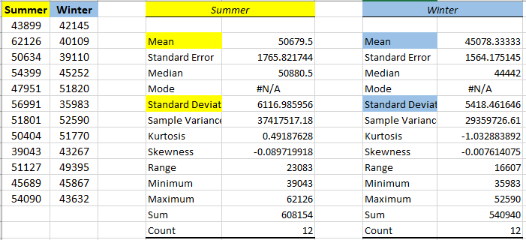
Data of steps through the different seasons
Population1 = count of steps walked through June, July, August (Summer)
Population2 = count of steps walked through December, January, February (Winter)
µ1 = mean of steps that were made through the summer season
µ2 = mean of steps that were made through the winter season

Slide 5
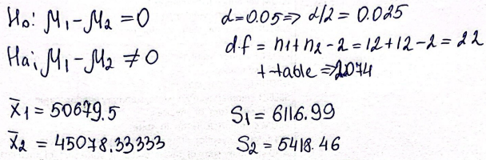
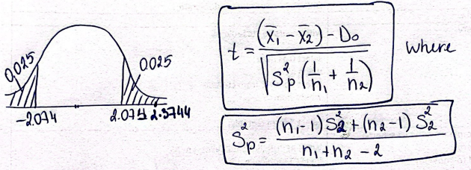
Calculation
Hypothesis testing at 0.05 level of significance. to determine if the sample data support the hypothesis the mean population steps/walking are different for summer and winter seasons.
Formulas and Rejection region
p-value = 0.0267 and t= 2.3744
Conclusion: Reject Ho since 2.3744 > 2.074 and 0.0267 < 0.05. There is sufficient evidence that the walking steps population mean in the summer season is different than in the winter season.

Slide 6
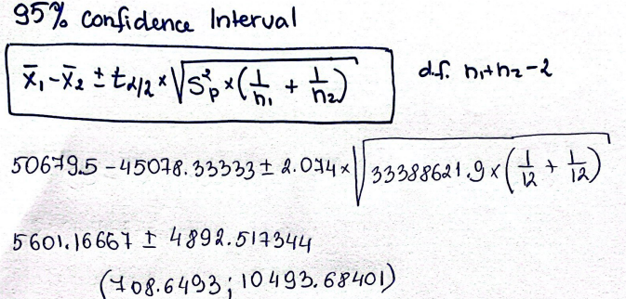
Calculation
95% confidence interval to estimate the difference in the population means
Conclusion: We are 95% confident that mean true differences in steps population mean is somewhere between 708.65 and 10493.68 walking steps.

Slide 7

Summarizing findings and any recommendations
Summarizing: there is statistical evidence that provides sufficient evidence to reject the null hypothesis, so we support the alternative hypothesis that the population mean of steps of walking during the summer season is different from the average steps of walked during the winter season.
Recommendations or suggestions: The more data we collect the smaller the confidence interval gets because the more values in our sample the bigger amount of total values will be close to the population total values, therefore we will have less error because our bigger sample will be closer to the population size.

Slide 8
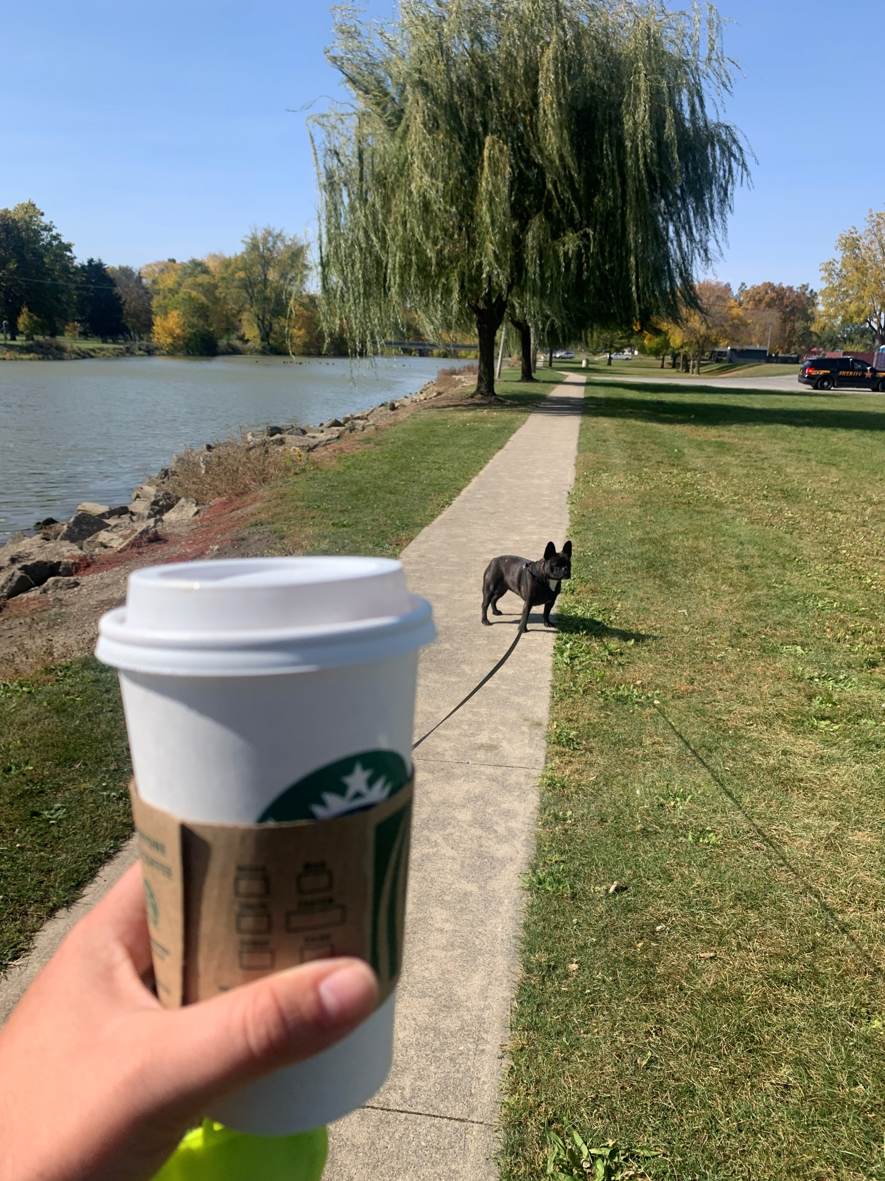
Conclusion
Statistically different, but practically according to the confidence interval there is not much difference in the steps count, but it is not much because it can be one extra short walk with my dog or an extra trip to Walmart because the interval is between 708 and 10493 steps which practically not that many steps.

